Slide 1
Decision Trees

Slide 2
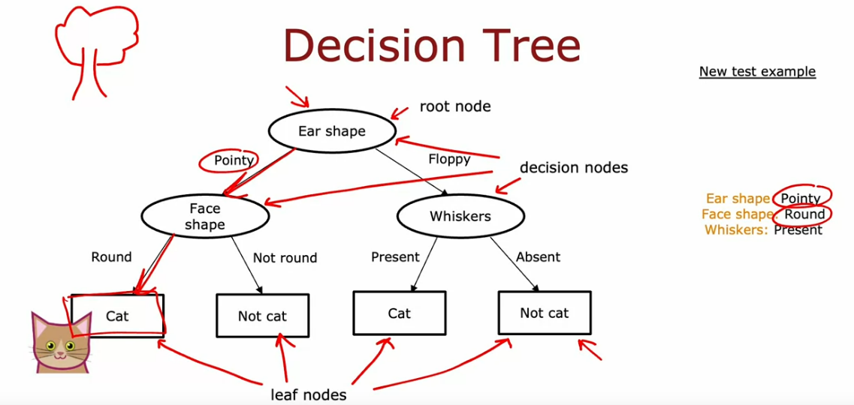
Decision Trees
One application area of the dtree algo is when the features (not the target), but the features themselves are categorical/discrete
Dtree algo contains nodes. Prediction often involves traversing thru the nodes
The topmost node is called the ROOT NODE.
The next set of nodes below the root node, except the final nodes, are called DECISION NODES
Finally, the bottom most nodes are called LEAF NODES
The job of the Dtree algo is to do the following – out of all possible Dtree’s, pick the one that does well on the training set and ideally generalizes well on new data

Slide 3
Decision Tree Learning
Step1: Decide the feature to use at the ROOT node. Then, further values are split based on this topmost feature
Step2: Focus on the sub-branch to decide the next node and decide the feature to split on next. Do this for 1 sub-branch at a time
Step3: Follow this process till no further splits are possible and a leaf node with only one category of the output/target is created. A node that is completely PURE (having the final target or subset of the target classified) is called the leaf node.
Note – Steps 2 & 3 are followed for 1 sub-branch at a time. This means, after the root node split, first focus on maybe the left sub-branch and reach the leaf node, and then focus on the right sub-branch
- The first key step in a dtree algorithm is to choose which features to split on at the root node. This decision is based on the feature providing the maximum PURITY (or minimum impurity)
The next key decision is to decide when to stop splitting. The following 4 criteria can be followed:
[1] Stop splitting when the node is 100% pure – only belonging to one class
[2] Stop splitting when splitting a node further will result in a tree exceeding a maximum depth. DEPTH = number of hops it takes to go from the root node to a particular node. The root node is depth 0, and the node right below it is depth 1, and so on
[3] Stop splitting when improvements in purity score are below a certain threshold
[4] Stop splitting when the number of training examples in a node is below a certain threshold

Slide 4
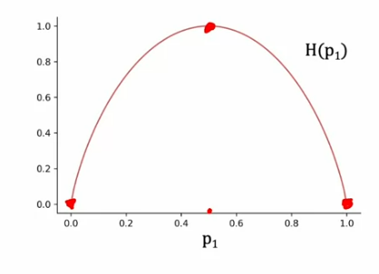
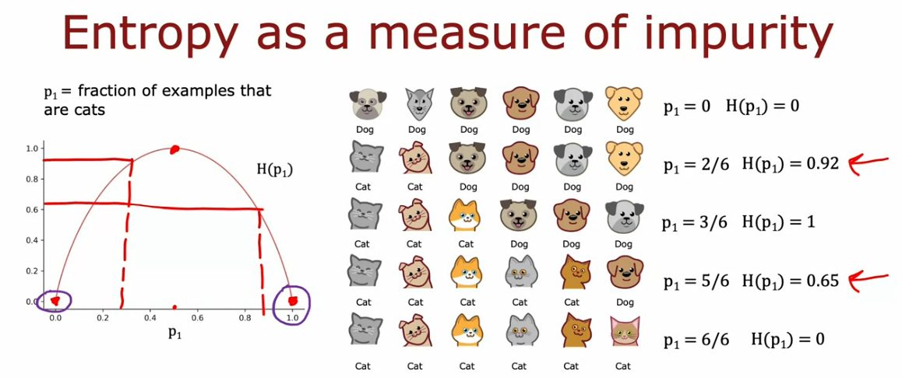
Measuring Purity
If training examples can be separated on a complete set of single class, they are said to be pure. Entropy is used for quantifying how pure are a set of examples. It is a measure of the impurity of certain data.
Let p1 = fraction of examples with label 1 (positive class) for a binary classification problem
The entropy function, denoted by H, looks like below:
NOTE – The horizontal axis is p1 ; The vertical axis is the value of entropy
The curve is the highest when the fraction of examples is 50-50 (implying most impure), denoted by an entropy of 1. Alternatively, if p1 is 0 or 1 (meaning if all values belong to the positive class entirely or NOT the positive class entirely), then the entropy is 0.
The higher the entropy, the more the impurity.
Interpretation of Entropy plot:
If p1 = 3/6 ➔ H(p1) = 1 ➔ maximum impurity
If p1 = 5/6 ➔ H(p1) = 0.65 ➔ impurity decreases
If p1 = 2/6 ➔ H(p1) = 0.92 ➔ impurity increases

Slide 5
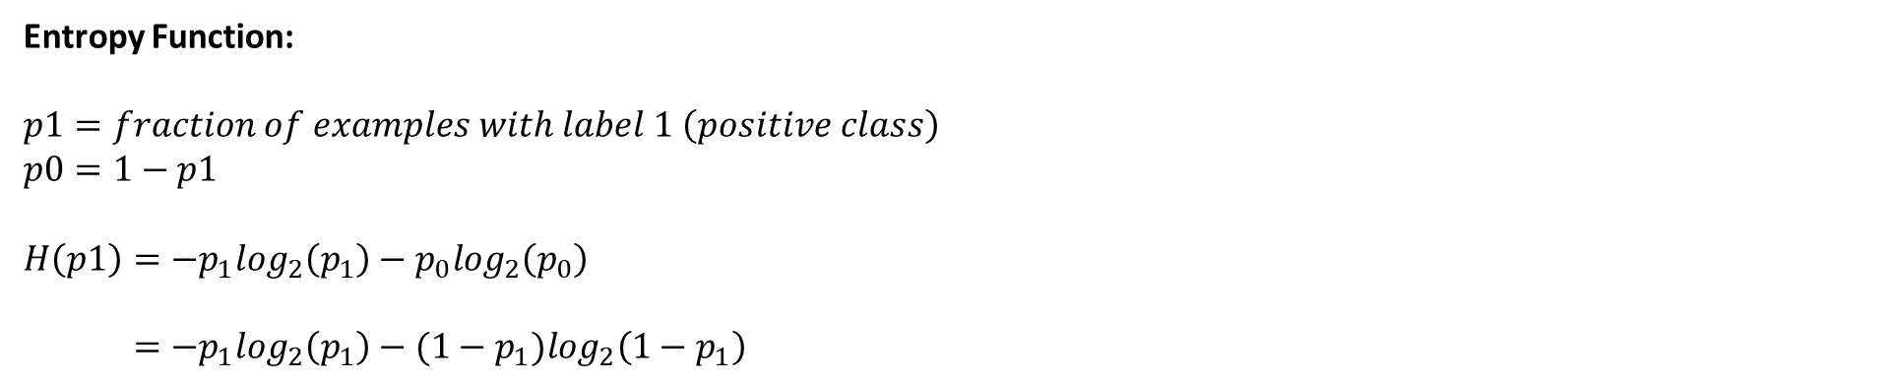
Entropy Function:
$$p1=fraction of examples with label 1 \left(positive class\right)$$
$$p0=1−p1$$
$$H\left(p1\right)=−p_{1}\log_{2}\left(p_{1}\right)−p_{0}\log_{2}\left(p_{0}\right)$$
$=−p_{1}\log_{2}\left(p_{1}\right)−(1−p_{1})\log_{2}\left(1−p_{1}\right)$
NOTE
Log base 2 instead of natural log is taken because base 2 vertically scales the function to 1 making the numbers easier to interpret
If p1 = 0; “0 log (0) = 0”
The gini criterion looks a lot like the entropy function but is a different measure of impurity
Information Gain: When deciding the feature to split on at the node, we will chose the feature that reduces entropy the most. This reduction of impurity is called INFORMATION GAIN
To choose the root node split
First split all the examples by each feature
Calculate the entropy of the left and right branches of the split
Take a weighted average (where weight is the number of training examples split) to calculate the final entropy
Calculate the reduction in entropy compare to if no split was performed

Slide 6
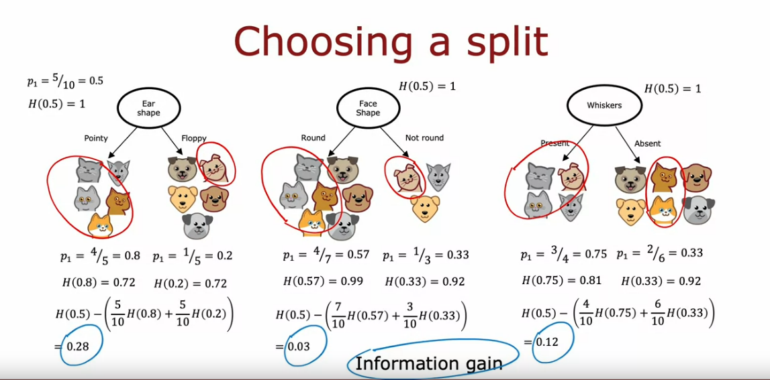
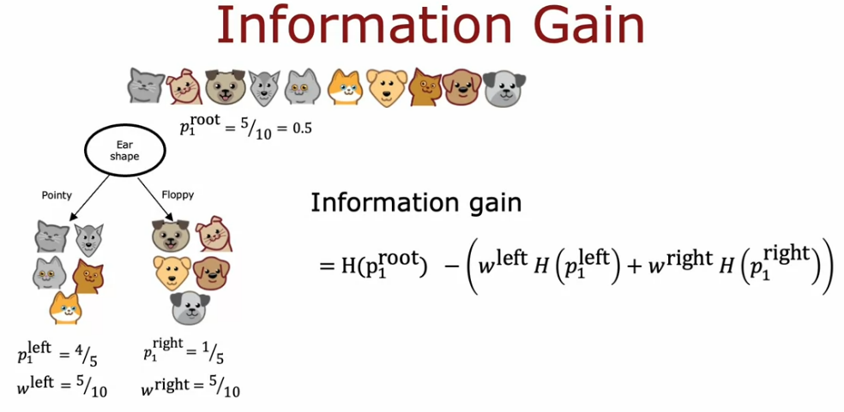
For the above – the original split on the target was 50% (5 cats and 5 dogs). Thus, at the root node, p1 = 0.5. Hence H(0.5) = 1

Slide 7
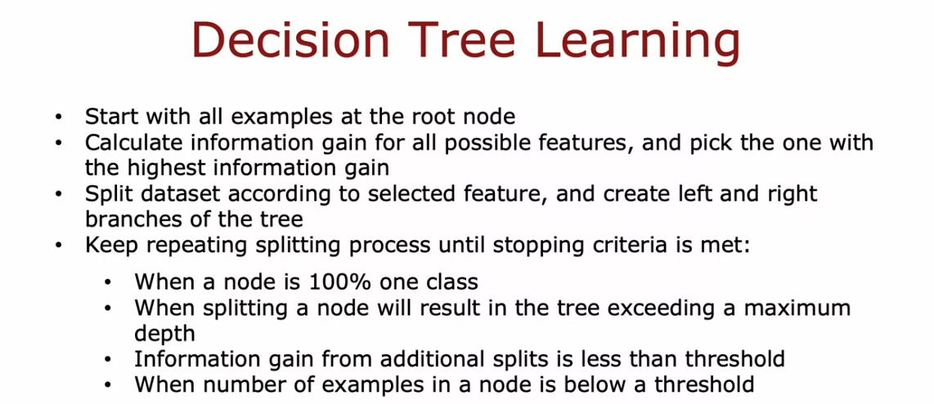
Overall Algorithm
The information gain idea can be extended to multiple nodes to build a decision tree. This is called recursive splitting
After the root node split, we first build out the left-most branch of the decision tree and then move to the right branch. Also, this is a top-down recursive process, so the lower branches are built using the same approach as the root node. The overall decision tree is built by building smaller sub-trees together and putting them all together.

Slide 8
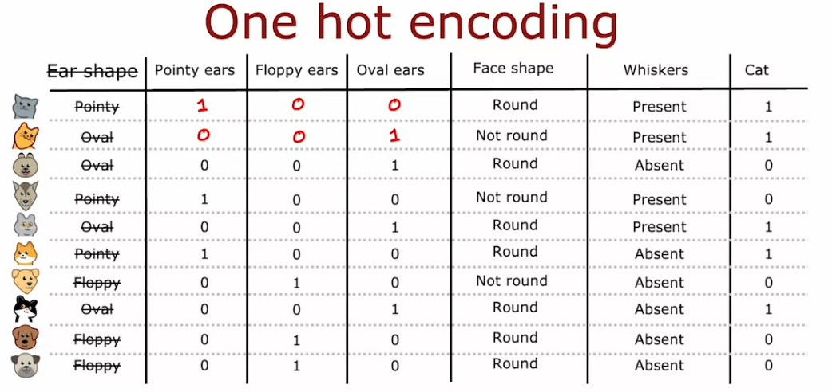
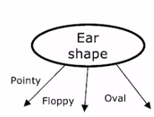
Choosing a splitting criterion
Max Depth – the larger the max depth, the bigger the dtree we are willing to build, and it’s a bit like fitting a higher degree polynomial or training a large NN. High max depth allows the dtree to learn a more complex model but also increases the risk of overfitting
Another criteria used for deciding when to stop splitting is if the information gained from an additional split is less than a certain threshold
Another criteria is to stop splitting when the number of training examples is below a certain threshold
To made a prediction using the dtree, start at the root node and keep following the decisions till you reach the leaf node.
One-Hot Encoding for Categorical Features
Use one-hot encoding to address features that have more than 2 discrete values.
If a certain categorical feature has 3 categories, instead of creating a dtree that will provide 3 splits (one for each category), we use one-hot encoding to create 3 discrete new features instead of using just 1 feature. Thus, instead of having 1 feature with 3 possible values, we create 3 features with 2 discrete values.
Avoid:
Instead:

Slide 9
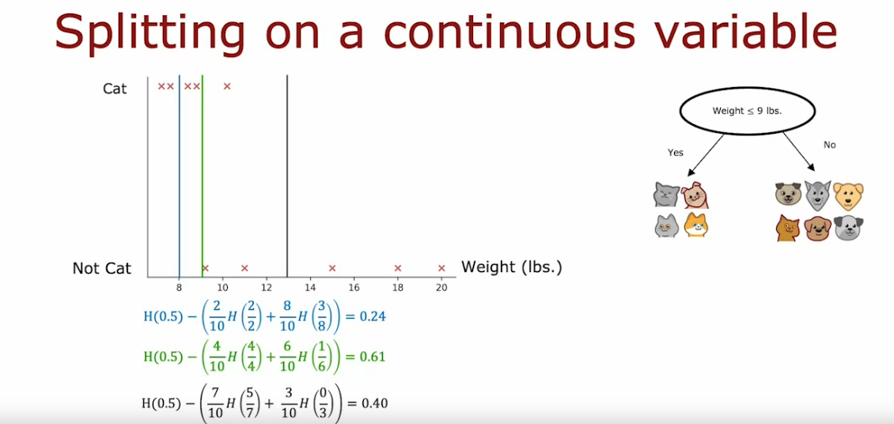
One-Hot Encoding ➔ If a categorical feature can take on k values, we create k binary features (0 or 1 valued). One of the k binary feature will always take a value of 1 (which is the one hot feature).
The idea of one-hot encoding can also be extended to NNs or any other algo before fitting the data
Continuous Value Features
When splitting on a continuous feature, the approach is to split based on a certain threshold. Many different values of this threshold need to be considered and the value that results in the best information gain needs to be picked.
One convention to choose thresholds is to sort all examples according to the value of the feature and then take all the values that are midpoints between the sorted list of training examples for that feature. Thus, if there are 5 training examples:
[1, 2, 3, 4, 5], the thresholds will be [1.5, 2.5, 3.5, 4.5] (a total of 4 threshold values)
To summarize, try different thresholds, use the information gain criteria to split on the continuous feature for the best threshold and build the dtree

Slide 10
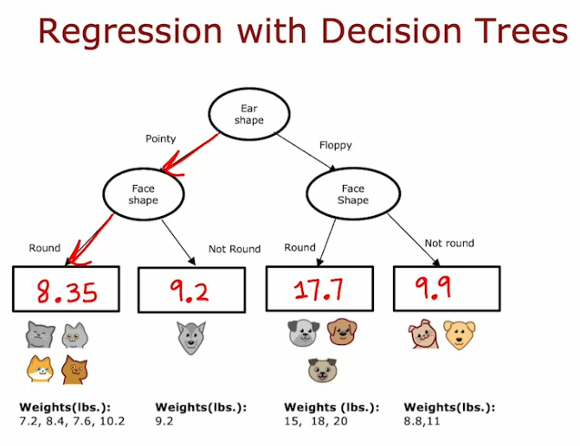
Regression Trees (Continuous Target)
- So far, we have only been talking about dtrees as a classification algo. We will now generalize dtrees to be a regression algo to predict a number.
- It is possible that a dtree may split on the same feature multiple times especially in the case of a continuous target.
- In case of prediction, if a test example comes down to a leaf node in a regression dtree, the prediction is going to be an average of the values of the leaf node

Slide 11
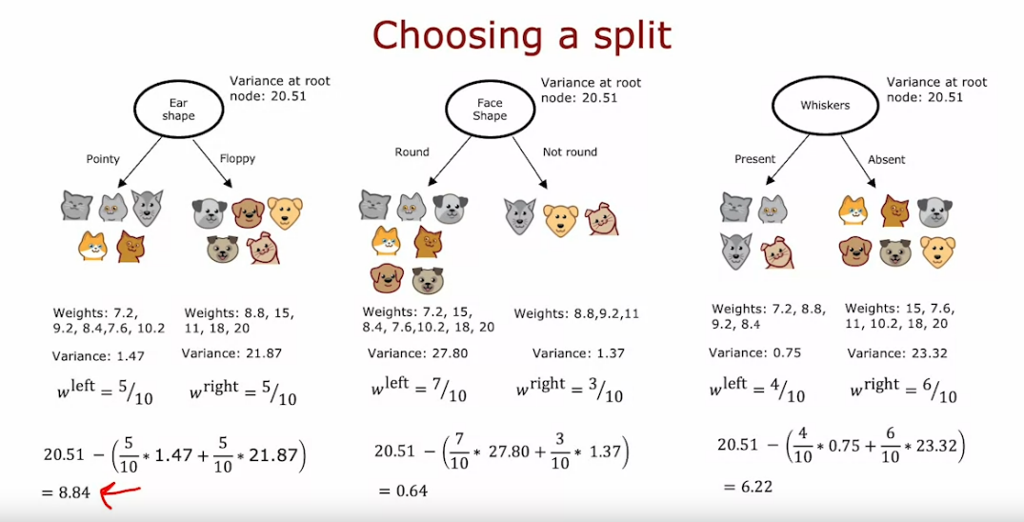
The change in concept of regression trees is that instead of trying to reduce the entropy, we now instead try to reduce the VARIANCE. Once the variance is calculated for the split, when then take the weighted average. This variance is then compared with the variance of all the training examples and the reduction in variance is calculated to build the tree

Slide 12
Tree Ensembles
A weakness of using a single decision tree is that single dtree can be highly sensitive to small changes in training data. One solution to make the algorithm more robust is to build not one but multiple dtrees to make the algo more robust. This is called Tree Ensembles.
Changing even a single training example can result in a different root node split. This would then result in building out totally different sub-tree on the left and the right
Simply put, a tree ensemble is a collection of multiple dtrees. Each of the individual tree is a plausible way of classifying the target. For a new test example classification, we then would run our example on each tree and get a vote on the final prediction
The reason for using ensembles is that by having a lot of dtrees and having them to vote, it makes the overall algorithm less sensitive to what any single dtree maybe doing.
To come up with different dtrees, we use the sampling with replacement technique – we will construct multiple random training sets that are slightly different from the original training set by using random selection with replacement (training examples will be repeated when randomly sampled).
Random Forest
Given a training set of size m:
For b = 1 to B trees:
Use sampling with replacement to create a new training set of size m
Train a dtree on the new dataset
- Get all the trees to vote on a final prediction

Slide 13
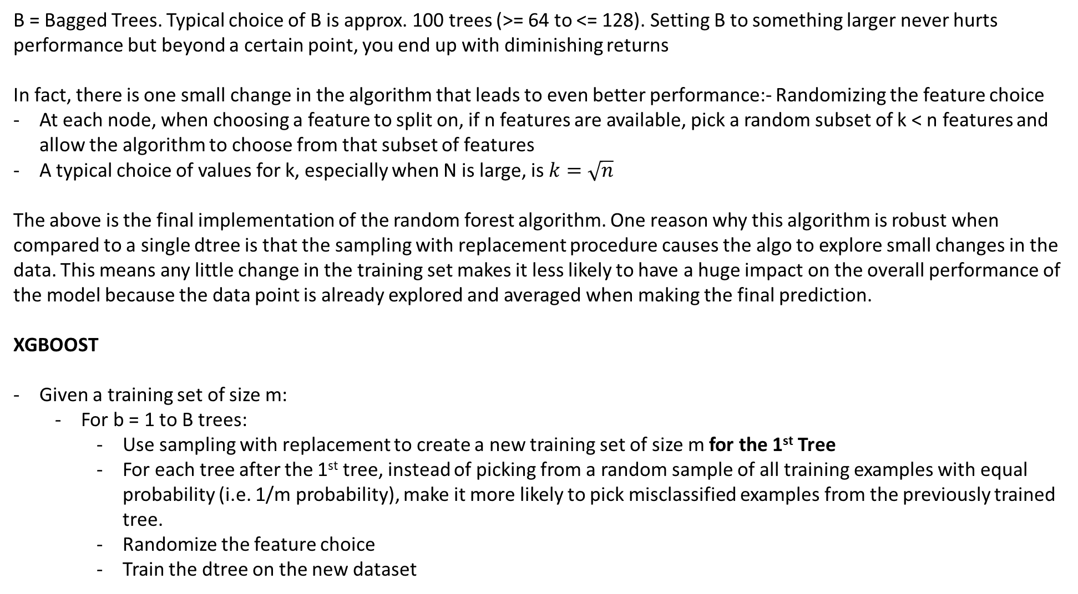
B = Bagged Trees. Typical choice of B is approx. 100 trees (>= 64 to <= 128). Setting B to something larger never hurts performance but beyond a certain point, you end up with diminishing returns
In fact, there is one small change in the algorithm that leads to even better performance:- Randomizing the feature choice
At each node, when choosing a feature to split on, if n features are available, pick a random subset of k < n features and allow the algorithm to choose from that subset of features
A typical choice of values for k, especially when N is large, is $k=\sqrt{n}$
The above is the final implementation of the random forest algorithm. One reason why this algorithm is robust when compared to a single dtree is that the sampling with replacement procedure causes the algo to explore small changes in the data. This means any little change in the training set makes it less likely to have a huge impact on the overall performance of the model because the data point is already explored and averaged when making the final prediction.
XGBOOST
Given a training set of size m:
For b = 1 to B trees:
Use sampling with replacement to create a new training set of size m for the 1st Tree
For each tree after the 1st tree, instead of picking from a random sample of all training examples with equal probability (i.e. 1/m probability), make it more likely to pick misclassified examples from the previously trained tree.
Randomize the feature choice
Train the dtree on the new dataset

Slide 14
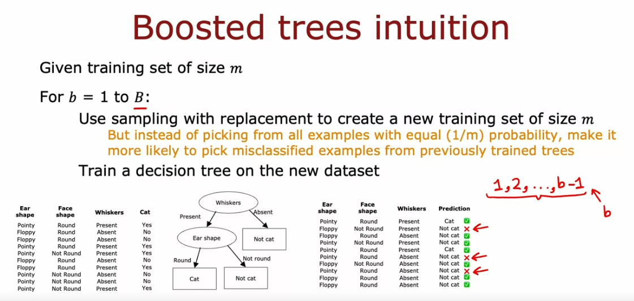
Thus, when building the next dtree, we focus on the subset of the training set that is still not doing well and get the next dtree to try to do well on the subset
Note:- misclassified examples are identified on the original training set. After building the 1st dtree, we go back to the original training set and tag the correct and incorrect predictions. When building the next tree, we use sampling with replacement to generate another training set, but when we randomly sample we give a higher chance of picking the misclassified examples. This misclassified training set becomes the focus of the next dtree. Thus, every progressive tree built focuses more on the on the misclassified examples.

Slide 15
The most popular boosting algorithm is XGBoost (Extreme Gradient Boosting) :
Open source implementation of boosted tree
Fast and efficient implementation
Good choice of default splitting criterion and when to stop splitting
Built in regularization to prevent overfitting (*)
Rather than sampling with replacement, XGB assigns different weights to different training examples and does not actually need to generate a lot of random training sets, making it more efficient
When to use Dtree vs NN?
Dtree and tree ensembles:
Work well on tabular (structured) data for both classification and regression problems
Not recommended for unstructured data (images, audio, text)
Fast to train
Small Dtrees may be human interpretable
Use XGB for better predictive accuracy
NNs:
Work on all types of data, including structured and unstructured, for classification or regression problems
Slower to train
Works with transfer learning
When building a system of multiple models working together, it may be easier to string together multiple NNs than dtrees, and the multiple NNs can be trained together using gradient descent whereas muiltiple trees will need to trained separately.

